Slide 1
Tutorial 09
Getting Started with JavaScript

Slide 2
Objectives
Insert a script element
Write JavaScript comments
Display an alert dialog box
Use browser debugging tools
Reference browser and page objects
Use JavaScript properties and methods

Slide 3
Objectives (continued)
Write HTML code and text content into a page
Work with a Date object
Use JavaScript operators
Create a JavaScript function
Create timed commands

Slide 4
Server-Side and Client-Side Programming
Server-side programming: Program code runs from the server hosting the website
Advantage
  Connects a server to an online database containing information not directly accessible to end users
Disadvantages
  Use server resources and requires Internet access
  Long delays in cases of system over-load

Slide 5
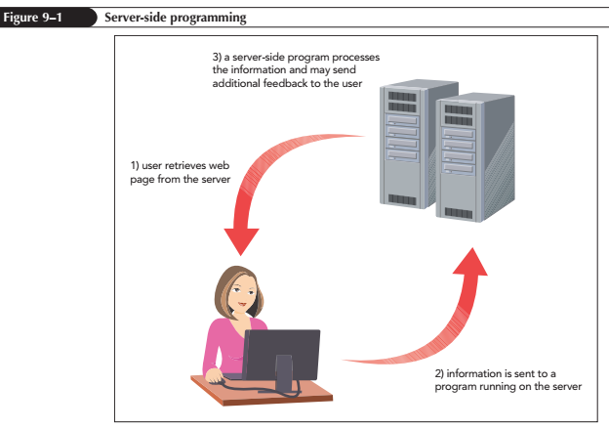
Server-Side and Client-Side Programming (continued 1)

Slide 6
Server-Side and Client-Side Programming (continued 2)
Client-side programming: Programs run on the user’s computer using downloaded scripts with HTML and CSS files
Distributes load to avoid overloading of program-related requests
Client-side programs can never replace server-side programming

Slide 7
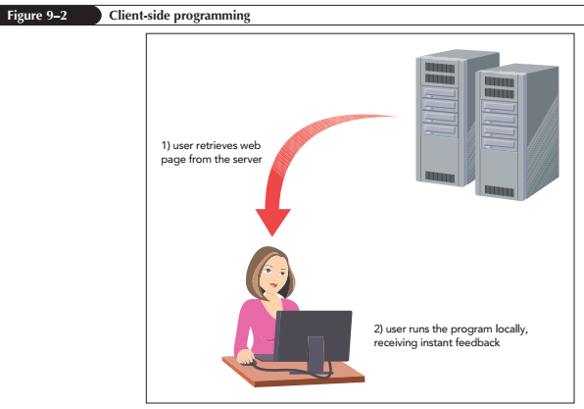
Server-Side and Client-Side Programming (continued 3)

Slide 8
The Development of JavaScript
JavaScript is a programming language for client-side programs
It is an interpreted language that executes a program code without using an application
Compiler is an application that translates a program code into machine language
JavaScript code can be directly inserted into or linked to an HTML file

Slide 9
Working with the script Element
JavaScript code is attached to an HTML file using the script element
<script src=”url”></script>
where url is the URL of the external file containing the JavaScript code
An embedded script can be used instead of an external file by omitting the src attribute
<script>
code
</script>

Slide 10
Loading the script Element
The script element can be placed anywhere within an HTML document
When a browser encounters a script, it immediately stops loading the page and begins loading and then processing the script commands
The async and defer attributes can be added to script element to modify its sequence of processing

Slide 11
Loading the script Element (continued)
The async attribute tells a browser to parse the HTML and JavaScript code together
The defer attribute defers script processing until after the page has been completely parsed and loaded
The async and defer attributes are ignored for embedded scripts

Slide 12
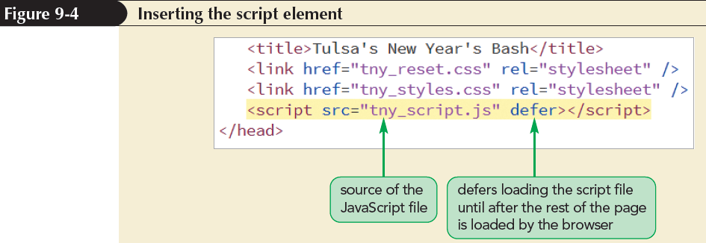
Inserting the script Element

Slide 13
Adding Comments to your JavaScript Code
A standard text editor can be used to create and edit JavaScript files
Adding comments to JavaScript code is an important programming practice
  Comments help others understand the design and purpose of programs
JavaScript comments can be entered on single or multiple lines

Slide 14
Adding Comments to your JavaScript Code (continued 1)
Syntax of a single-line comment:
// comment text
or
command; // comment text
Syntax of multiple-line comments:
/*
comment text spanning
several lines
*/

Slide 15
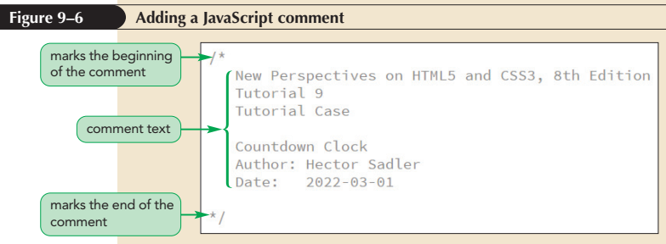
Adding Comments to your JavaScript Code (continued 2)

Slide 16
Writing a JavaScript Command
Every JavaScript program consists of a series of commands or statements
Each command is a single line that indicates an action for the browser to take
A command should end in a semicolon, employing the following syntax:
  JavaScript command;

Slide 17
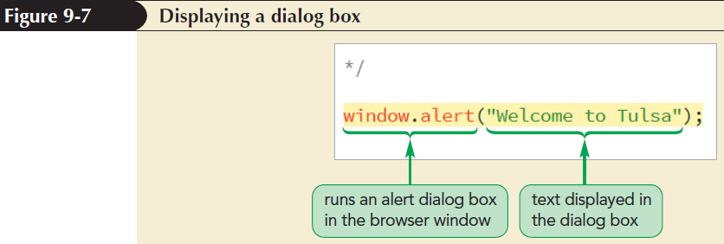
Writing a JavaScript Command (continued 1)

Slide 18
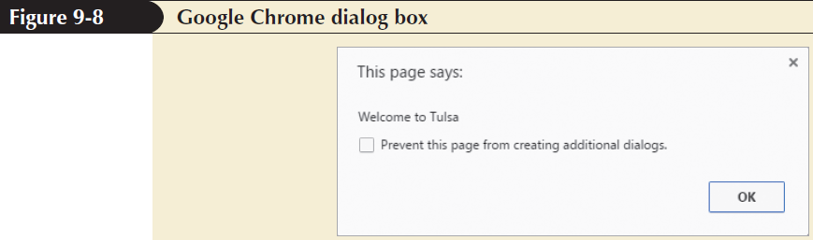
Writing a JavaScript Command (continued 2)

Slide 19
Understanding JavaScript Syntax
Syntax rules for JavaScript commands
  JavaScript is case sensitive
  Extra white space between commands is ignored
  Line breaks placed within the name of a JavaScript command or a quoted text string cause an error

Slide 20
Debugging Your Code
Debugging: Process of locating and fixing a programming error
Types of errors
  Load-time errors – occur when a script is first loaded by a browser
  Run-time errors – occur during execution of a script without syntax errors
  Logical errors – are free from syntax and executable mistakes but result in an incorrect output

Slide 21
Opening a Debugger
Debugging tools locate and fix errors in JavaScript codes
Shortcut to open a debugging tool is F12 key
The tools can also be opened by selecting Developer Tools from the browser menu

Slide 22
Inserting a Breakpoint
A useful technique to locate the source of an error is to set up breakpoints
Breakpoints are locations where a browser pauses a program to determine whether an error has occurred at that point during execution

Slide 23
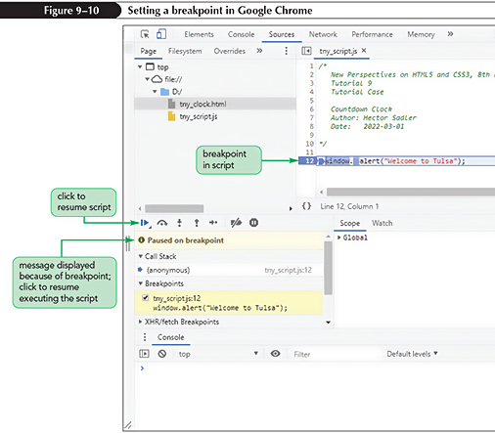
Inserting a Breakpoint (continued)

Slide 24
Applying Strict Usage of JavaScript
Strict mode enables all lapses in syntax to result in load-time or run-time errors
To run a script in strict mode, add the following statement to the first line of the file:
“use strict”;

Slide 25
Introducing Objects
Object: Entity within a browser or web page that has properties and methods
Properties: Define objects
Methods: Act upon objects
JavaScript is an object-based language that manipulates an object by changing one or more of its properties

Slide 26
Introducing Objects (continued 1)
Types of JavaScript objects
  Built-in objects – intrinsic to JavaScript language
  Browser objects – part of browser
  Document objects – part of web document
  Customized objects – created by a programmer to use in an application
Browser object model (BOM) and document object model (DOM) organize browser and document objects in hierarchical structures, respectively

Slide 27
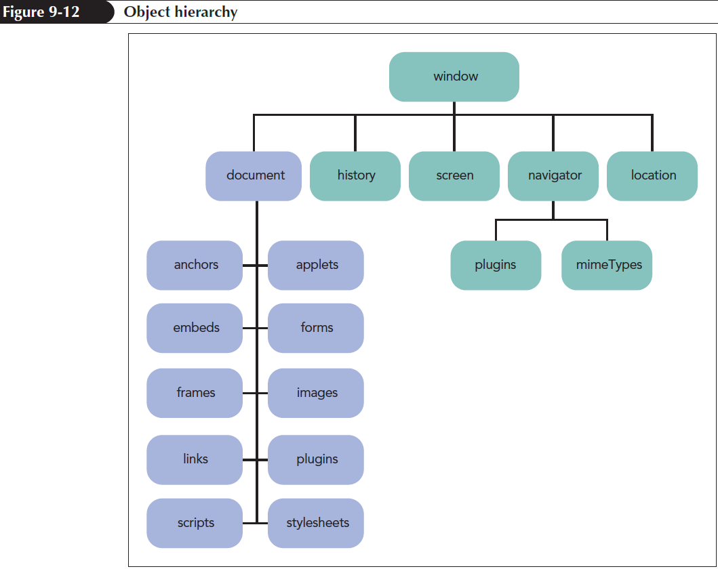
Introducing Objects (continued 2)

Slide 28
Object References
Objects within the object hierarchy are referenced by their object names such as window, document, or navigator
Objects can be referenced using the notation
object1.object2.object3 ...
where object1 is at the top of the hierarchy, object2 is a child of object1, and so on

Slide 29
Referencing Object Collections
Object collections: Objects organized into groups
To reference a specific member of an object collection, use
collection[idref]
or collection.idref
where collection is a reference to the object collection and idref is either an index number or the value of id attribute

Slide 30
Referencing Object Collections (continued)
Object Collection | References
document.anchors | All elements marked with the <a> tag
document.applets | All applet elements
document.embeds | All embed elements
document.forms | All web forms
document.frames | All frame elements
document.images | All inline images
document.links | All hypertext links
document.plugins | All plug-ins supported by the browser
document.scripts | All script elements
document.styleSheets | All stylesheet elements

Slide 31
Referencing an Object by ID and Name
An efficient approach to reference an element is to use its id attribute using the expression
document.getElementById(id)
where id is the value of id attribute

Slide 32
Changing Properties and Applying Methods
An object can be modified in two ways:
  By changing the object’s properties
  By applying a method

Slide 33
Object Properties
Object property is accessed using:
object.property
where object is a reference to an object and property is a property associated with that object
Read-only properties cannot be modified

Slide 34
Applying a Method
Objects can be modified using methods
Methods are applied using the expression:
object.method(values)
where object is a reference to an object, method is the name of the method applied to the object, and values is a comma-separated list of values associated with the method

Slide 35
Writing HTML Code
HTML code stored within a page element is referenced using
element.innerHTML
where element is an object reference to an element within a web document
For example:
/* Display the current date and time */
document.getElementById(“dateNow”).innerHTML = “m/d/y<br />h:m:s”;

Slide 36
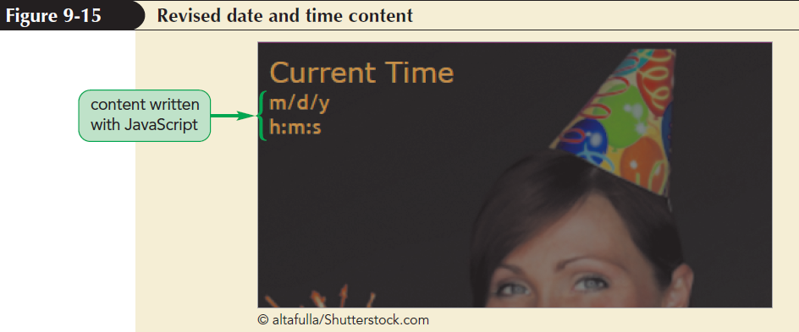
Writing HTML Code (continued 1)

Slide 37
Writing HTML Code (continued 2)
Property or Method | Description
element.innerHTML | Returns the HTML code within element
element.outerHTML | Returns the HTML code within element as well as the HTML code of element itself
element.textContent | Returns the text within element disregarding any HTML tags
element.insertAdjacentHTML(position, text) | Inserts HTML code defined by text into element at position, where position is one of the following:’beforeBegin’ (before the element’s opening tag), ‘afterBegin’ (right after the element’s opening tag), ‘beforeEnd’ (just before the element’s closing tag), or ‘afterEnd’ (after the element’s closing tag)

Slide 38
Working with Variables
JavaScript is much more powerful and versatile when used in conjunction with variables
A variable is a named item in a program that stores a data value, such as a number or text string, or an object, such as a part of the web browser or browser window
Variables are useful because they can store information created in one part of the script and use that information elsewhere

Slide 39
Declaring a Variable
Introduced into a script by declaring the variable using the var keyword
var variable = value;
where variable is the name assigned to the variable and value is the variable’s initial value
An initial value does not have to be supplied to a variable
Multiple variables can be declared by entering the variable names in a comma separated list

Slide 40
Declaring a Variable (continued)
Conditions to assign variable names in JavaScript
  First character must be either a letter or an underscore character ( _ )
  The characters after the first character can be letters, numbers, or underscore characters
  No spaces
  No using names that are part of JavaScript language

Slide 41
Variables and Data Types
Data type: Type of information stored in a variable
Supported data types
  Numeric value
  Text string
  Boolean value
  Object
  null value

Slide 42
Variables and Data Types
(continued 1)
Numeric value: Any number
Text string: Group of characters enclosed within either double or single quotation marks
Boolean value: Indicates the truth or falsity of a statement

Slide 43
Variables and Data Types
(continued 2)
Object – Simplifies code by removing the need to rewrite complicated object references
null value – Indicates that no value has yet been assigned to a variable

Slide 44
Using a Variable
After a variable is created, it can be used in JavaScript statements in place of the value it contains
  Inserting the variable name into a command or expression
Example:
var dateDiv = document.getElementById("dateNow");
dateDiv.innerHTML = "May 3, 2021";

Slide 45
Using a Variable (continued)
Obtain the same effect as if the following command had been inserted into the program:
document.getElementById("dateNow").innerHTML = "May 3, 2021";
Advantage of defining the dateDiv variable
  Can be used throughout the program
  Speeds up the execution of the code
  Makes program easier to read and manage

Slide 46
Working with Date Objects
Date object: Built-in JavaScript object used to store information about dates and times
Defined using the following expression:
new Date("month day, year hrs:mins:secs");
where month, day, year, hrs, mins, and secs provide the Date object’s date and time

Slide 47
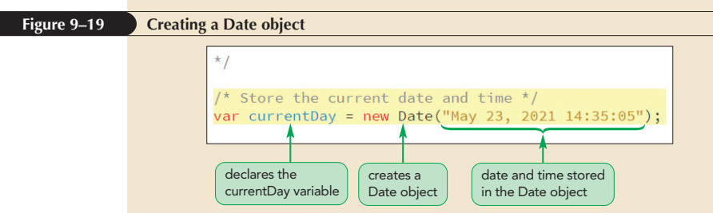
Creating a Date Object

Slide 48
Applying Date Methods
Assume the following code:
var thisDay = new Date(“May 23, 2021 14:35:05”);
Method | Description | Results
thisDay.getSeconds() | seconds | 5
thisDay.getMinutes() | minutes | 35
thisDay.getHours() | hours | 14
thisDay.getDate() | day of the month | 23
thisDay.getMonth() | month number, where January = 0, February =1, etc. | 4

Slide 49
Applying Date Methods
(continued 1)
Assume the following code:
var thisDay = new Date(“May 23, 2021 14:35:05”);
Method | Description | Results
thisDay.getFullYear() | year | 2021
thisDay.getDay() | day of the week, where Sunday = 0, Monday = 1, etc. | 0
thisDay.toLocaleDateString() | text of the date using local conventions | “5/23/2021”
thisDay.toLocaleTimeString() | text of the time using local conventions | “2:35:05 PM”

Slide 50
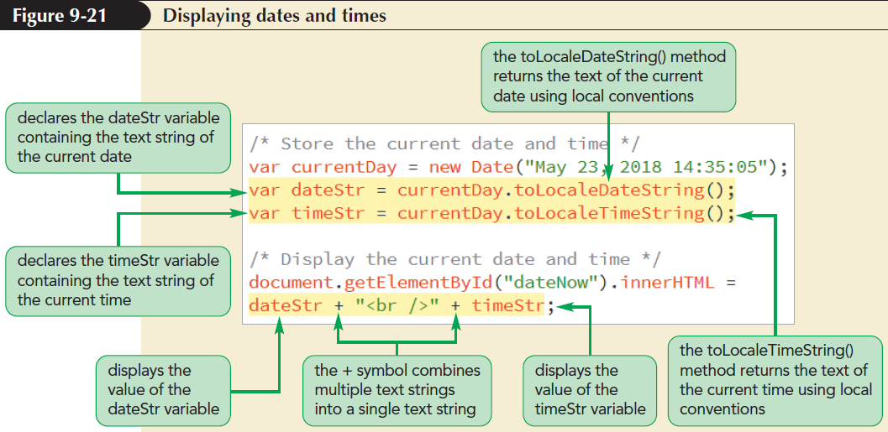
Applying Date Methods
(continued 2)

Slide 51
Setting Date and Time Values
Date Method | Description
date.setDate(value) | Sets the day of the month of date, where value is an integer, ranging from 1 up to 31 (for some months)
date.setFullYear(value) | Sets the four-digit year value of date, where value is an integer
date.setHours(value) | Sets the 24-hour value of date, where value is an integer ranging from 0 to 23
date.setMilliseconds(value) | Sets the millisecond value of date, where value is an integer between 9 and 999

Slide 52
Setting Date and Time Values
(continued)
Date Method | Description
date.setMinutes(value) | Sets the minutes value of date, where value is an integer ranging from 0 to 59
date.setMonth(value) | Sets the month value of date, where value is an integer ranging from 0 (January) to 11 (December)
date.setSeconds(value) | Sets the seconds value of date, where value is an integer ranging from 0 to 59
date.setTime(value) | Sets the time value of date, where value is an integer representing the number of milliseconds since midnight on January 1, 1970

Slide 53
Working with Operators and Operands
Operator: Symbol used to act upon an item or a variable within an expression
Operands: Variables or expressions that operators act upon
The + operator functions
  Can be used to add two or more numbers to calculate a sum
  Can be used to combine two or more text strings into a single text string

Slide 54
Working with Operators and Operands (continued 1)
Operator | Description | Expression | Returns
+ | Combines or adds two items | 12 + 3 | 15
– | Subtracts one item from another | 12 – 3 | 9
* | Multiplies two items | 12*3 | 36
/ | Divides one item by another | 12/3 | 4
% | Returns the remainder after dividing one item by another | 18%5 | 3
++ | Increases a value by 1 | 12++ | 13
– – | Decreases a value by 1 | 12– – | 11
– | Changes the sign of a value | –12 | –12

Slide 55
Working with Operators and Operands (continued 2)
Types of operators
  Binary operators – require two operands in an expression
  Unary operators – require only one operand
    Increment operator (++) – increases the value of an operand by 1
    Decrement operator (--) – decreases the value of an operand by 1

Slide 56
Using Assignment Operators
Assignment operator assigns a value to an item
Most common assignment operator is the equal sign ( = )
  Assigns the value of one expression to another
The act of assigning a value and changing a value within a single operator can be combined in JavaScript
x = x + 2;
x += 2;

Slide 57
Using Assignment Operators (continued)
Operator | Example | Equivalent To
= | x = y | x = y
+= | x += y | x = x + y
–= | x –= y | x = x – y
*= | x *= y | x = x * y
/= | x /= y | x = x /y
%= | x %= y | x = x % y

Slide 58
Working with the Math Object
Math object: Built-in object used to perform mathematical tasks and store mathematical values
Syntax to apply a Math method:
Math.method(expression)
where method is the method applied to a mathematical expression

Slide 59
Working with the Math Object (continued 1)
Method | Description | Example | Returns
Math.abs(x) | Returns the absolute value of x | Math.abs(–5) | 5
Math.ceil(x) | Rounds x up to the next highest integer | Math.ceil(3.58) | 4
Math.exp(x) | Raises e to the power of x | Math.exp(2) | e² (approximately 7.389)
Math.floor(x) | Rounds x down to the next lowest integer | Math.floor(3.58) | 3
Math.log(x) | Returns the natural logarithm of x | Math.log(2) | 0.693
Math.max(x, y) | Returns the larger of x and y | Math.max(3, 5) | 5

Slide 60
Working with the Math Object (continued 2)
Method | Description | Example | Returns
Math.min(x, y) | Returns the smaller of x and y | Math.min(3, 5) | 3
Math.pow(x, y) | Returns x raised to the power of y | Math.pow(2,3) | 2³ (or 8)
Math.rand() | Returns a random number between 0 and 1 | Math.rand() | Random number between 0 and 1
Math.round(x) | Rounds x to the nearest integer | Math.round(3.58) | 4
Math.sqrt(x) | Returns the square root of x | Math.sqrt(2) | approximately 1.414

Slide 61
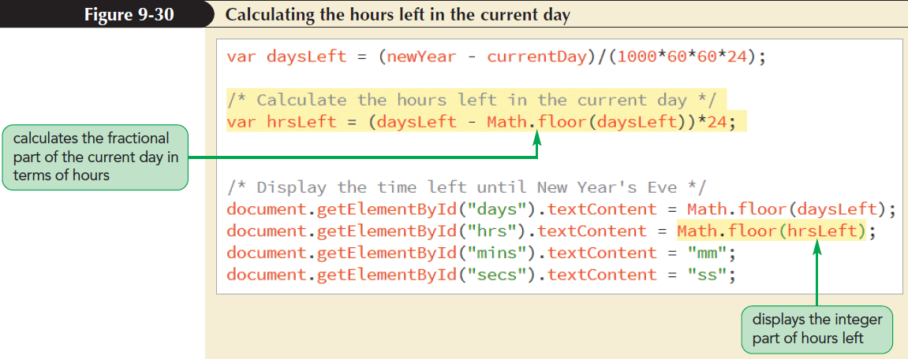
Working with the Math Object (continued 3)

Slide 62
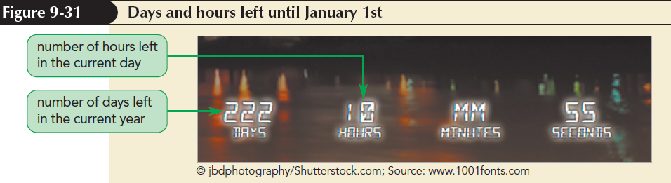
Working with the Math Object (continued 4)

Slide 63
Using Math Constants
Math functions refer to built-in constants stored in JavaScript Math object
Syntax to access mathematical constants is
Math.CONSTANT
where CONSTANT is the name of one of the mathematical constants supported by Math object

Slide 64
Using Math Constants (continued)
Constant | Description
Math.E | The base of the natural logarithms (2.71828…)
Math.LN10 | The natural logarithm of 10 (2.3026…)
Math.LN2 | The natural logarithm of 2 (0.6931…)
Math.LOG10E | The base 10 logarithm of e (0.4343…)
Math.LOG2E | The base 2 logarithm of e (1.4427…)
Math.PI | The value of π (3.14159…)
Math.SQRT1_2 | The value of 1 divided by the square root of 2 (0.7071…)
Math.SQRT2 | The square root of 2 (1.4142 …)

Slide 65
Working with JavaScript Functions
Function: Collection of commands that performs an action or returns a value
A function name identifies a function and a set of commands that are run when the function is called
Parameters: Variables associated with the function

Slide 66
Working with JavaScript Functions
(continued)
General syntax of a JavaScript function is:
function function_name(parameters){
commands
}
where,
function_name is the name of the function
parameters is a comma-separated list of variables used in the function
commands is the set of statements run by the function

Slide 67
Calling a Function
A function must be called to run
  If it has parameters, the initial values of the parameters are set when the function is called
Expression to call a function and run it:
function_name(parameter values)
where function_name is the name of the function and parameter values is a comma-separated list of values that match the parameters of the function

Slide 68
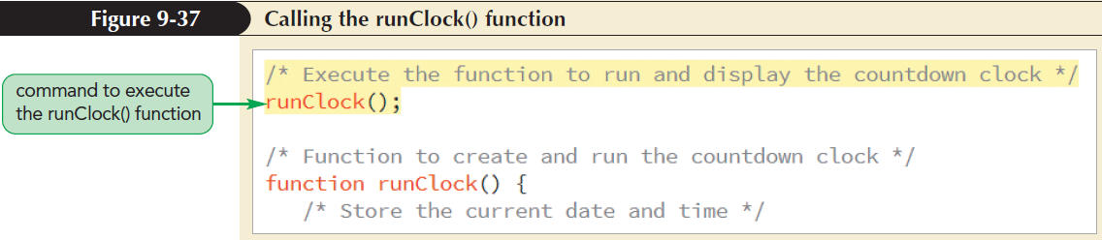
Calling a Function (continued)

Slide 69
Creating a Function to Return a Value
Functions return values using the return statement
function function_name(parameters){
commands
return value;
}
where value is the calculated value that is returned by the function

Slide 70
Running Timed Commands
Two ways to update the current time and the remaining time constantly
  Time-delayed commands
  Timed-interval commands

Slide 71
Working with Time-Delayed Commands
Time-delayed command - run after a specified amount of time has passed
Time delay is defined using the following:
setTimeout(“command”, delay);
where command is a JavaScript command and delay is the delay time in milliseconds before a browser runs the command
The command must be placed within either double or single quotation marks

Slide 72
Working with Time-Delayed Commands (continued)
To cancel a time-delayed command:
clearTimeout();
Browser can process unlimited number of time-delayed commands
Can assign a unique identification number to distinguish commands
var timeID = setTimeout("command", delay);
where timeID is a variable that stores the ID of the time-delayed command

Slide 73
Running Commands at Specified Intervals
A timed-interval command instructs browsers to run a command repeatedly at a specified interval
Timed-interval command syntax:
setInterval("command", interval);
where interval is the interval in milliseconds before the command is run again
Timed-interval commands are halted using the following statement:
clearInterval();

Slide 74
Running Commands at Specified Intervals (continued 1)
Distinguish one timed-interval command from another by storing the time ID in a variable
var timeID = setInterval("command", interval);
Halt the timed-interval command by applying the clearInterval() method with
timeID as the parameter value:
clearInterval(timeID);

Slide 75
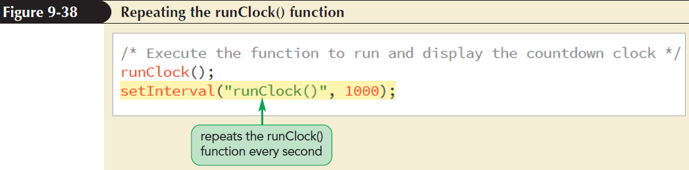
Running Commands at Specified Intervals (continued 2)

Slide 76
Handling Illegal Operations
Mathematical operations can return results that are not numeric values
JavaScript returns NaN value
  Stands for “Not A Number”
  Indicates an illegal operation that should involve only numeric values

Slide 77
Handling Illegal Operations (continued 1)
Check for the nonnumeric results error using the isNaN() function
isNaN(value)
where value is the value or variable to test for being numeric
isNaN() function returns a Boolean value
  True if the value is not numeric
  False otherwise

Slide 78
Handling Illegal Operations (continued 2)
Infinity value
  Generated for an operation whose result is less than the smallest numeric value and greater than the largest numeric value supported by JavaScript
Can check for this outcome using:
isFinite(value)
where value is the value you want to test for being finite

Slide 79
Handling Illegal Operations (continued 3)
isFinite() function returns a Boolean value
  True if the value is a finite number falling within JavaScript’s acceptable range
  False if the numeric value falls outside that range or if the value is not a number at all

Slide 80
Defining a Number Format
JavaScript stores a numeric value to 16 decimal places of accuracy
The number of digits displayed by browsers is controlled using toFixed() method
value.toFixed(n)
where value is the value or variable and n is the number of decimal places displayed in the output

Slide 81
Defining a Number Format (continued)
toFixed() limits the number of decimals displayed by a value and converts the value into a text string
toFixed() rounds the last digit in an expression rather than truncating it

Slide 82
Converting Between Numbers and Text
+ operator adds a text string to a number
For example,
testNumber = 123; // numeric value
testString = testNumber + “”; // text string
where + operator concatenates a numeric value with an empty text string resulting in a text string

Slide 83
Converting Between Numbers and Text (continued 1)
The parseInt() function extracts the leading integer value from a text string
  Returns the integer value from the text string by discarding any non-integer characters
Example:
parseInt(“120.88 lbs”); // returns 120
parseInt(“weight equals 120 lbs”); // returns NaN

Slide 84
Converting Between Numbers and Text (continued 2)
Numerical Function | Description
isFinite(value) | Indicates whether value is finite and a real number
isNaN(value) | Indicates whether value is a number
parseFloat(string) | Extracts the first numeric value from the text string
parseInt(string) | Extracts the first integer value from the text string
Numerical Method | Description
value.toExponential(n) | Returns a text string displaying value in exponential notation with n digits to the right of the decimal point
value.toFixed(n) | Returns a text string displaying value to n decimal places
value.toPrecision(n) | Returns a text string displaying value to n significant digits either to the left or to the right of the decimal point

